Slide 1

Explainable Artificial Intelligence for Diabetes Prediction
LOCAL INTERPRETABLE MODEL-AGNOSTIC EXPLANATIONS (LIME)
LIME GENERAL APPROACH
LIME MATHEMATICAL OPTIMITZATION PROBLEM
LIME STEP BY STEP
LIME DISADVANTAGES

Slide 2
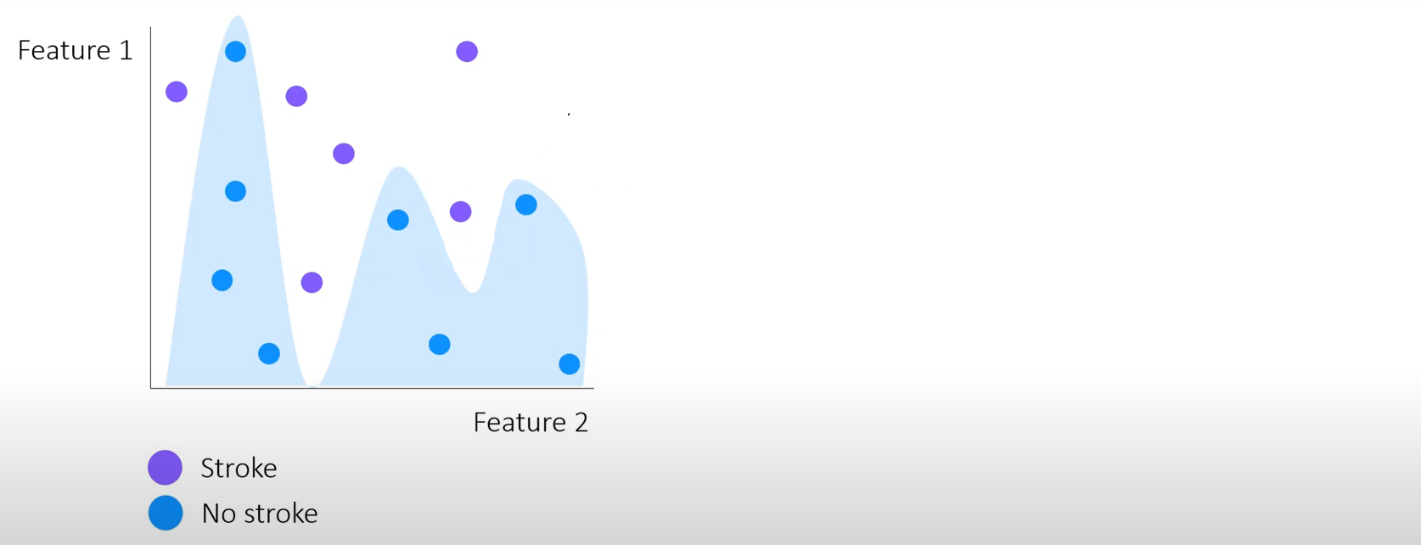
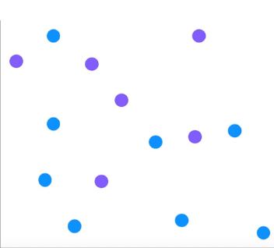
Explainable Artificial Intelligence for Diabetes Prediction
LIME GENERAL APPROACH
No stroke Stroke

Slide 3
Explainable Artificial Intelligence for Diabetes Prediction
LIME GENERAL APPROACH
No stroke Stroke

Slide 4
Explainable Artificial Intelligence for Diabetes Prediction
LIME GENERAL APPROACH
No stroke Stroke

Slide 5
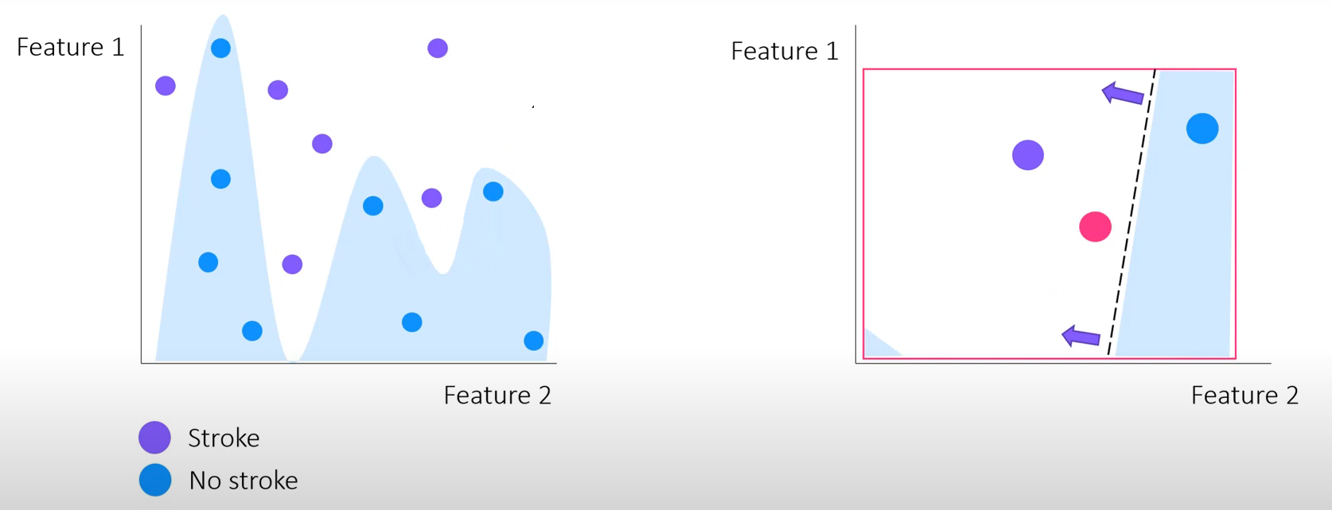



Explainable Artificial Intelligence for Diabetes Prediction
LIME GENERAL APPROACH
No stroke Stroke

Slide 6
Explainable Artificial Intelligence for Diabetes Prediction
LIME GENERAL APPROACH
No stroke Stroke
No stroke Stroke

Slide 7
Explainable Artificial Intelligence for Diabetes Prediction
LIME GENERAL APPROACH
No stroke Stroke
No stroke Stroke
COMPLEX MODEL
LINEAR MODEL

Slide 8
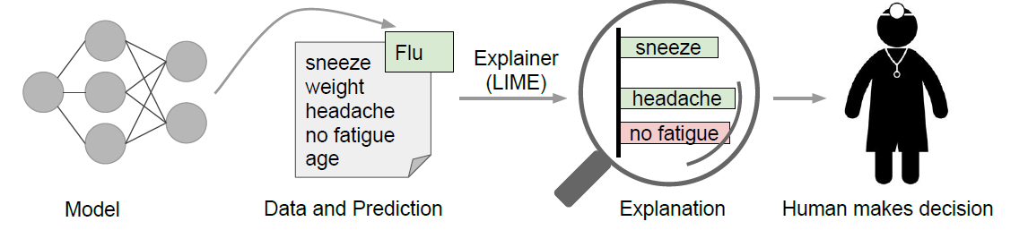
Explainable Artificial Intelligence for Diabetes Prediction
LIME GENERAL APPROACH

Slide 9
Explainable Artificial Intelligence for Diabetes Prediction
LIME GENERAL APPROACH
Select your instance of interest for which you want to have an explanation of its black box prediction.
Perturb your dataset and get the black box predictions for these new points.
Weight the new samples according to their proximity to the instance of interest.
Train a weighted, interpretable model on the dataset with the variations.
Explain the prediction by interpreting the local model.

Slide 10
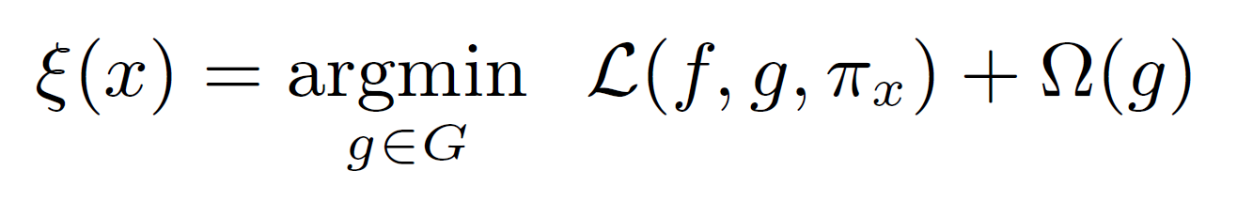
Explainable Artificial Intelligence for Diabetes Prediction
LIME MATHEMATICAL OPTIMITZATION PROBLEM

Slide 11

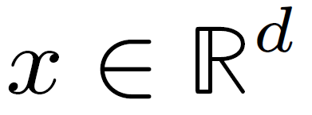

Explainable Artificial Intelligence for Diabetes Prediction
LIME MATHEMATICAL OPTIMITZATION PROBLEM
number of features

Slide 12
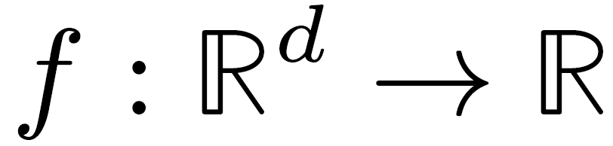
Explainable Artificial Intelligence for Diabetes Prediction
LIME MATHEMATICAL OPTIMITZATION PROBLEM
Complex model
number of features

Slide 13
Explainable Artificial Intelligence for Diabetes Prediction
LIME MATHEMATICAL OPTIMITZATION PROBLEM
Complex model
Simple
interpretable
model
number of features

Slide 14
Explainable Artificial Intelligence for Diabetes Prediction
LIME MATHEMATICAL OPTIMITZATION PROBLEM
Complex model
Family of
interpretable
models
Simple
interpretable
model
number of features

Slide 15
Explainable Artificial Intelligence for Diabetes Prediction
LIME MATHEMATICAL OPTIMITZATION PROBLEM
Complex model
Neighbourhood of x
Family of
interpretable
models
Simple
interpretable
model
number of features

Slide 16
Explainable Artificial Intelligence for Diabetes Prediction
LIME MATHEMATICAL OPTIMITZATION PROBLEM
(1)
(2)
Complex model
Neighbourhood of x
Family of
interpretable
models
Simple
interpretable
model
number of features
2 LOSS TERMS

Slide 17





Explainable Artificial Intelligence for Diabetes Prediction
LIME STEP BY STEP

Slide 18
Explainable Artificial Intelligence for Diabetes Prediction
Select your instance of interest for which you want to have an explanation of its black box prediction

Slide 19
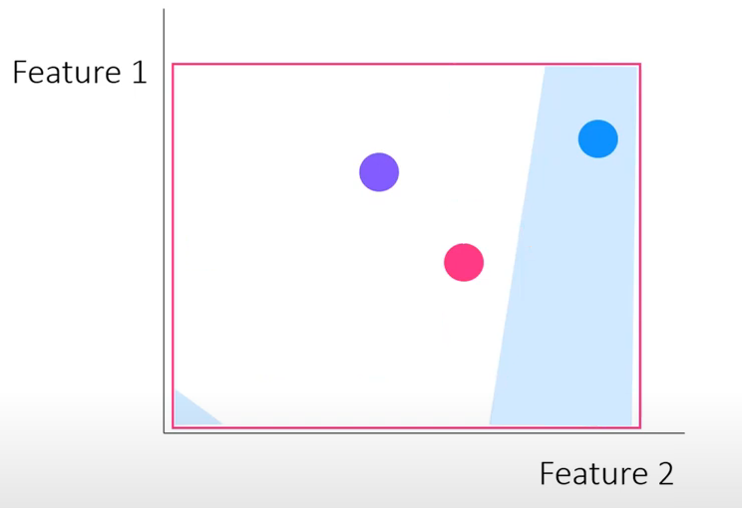
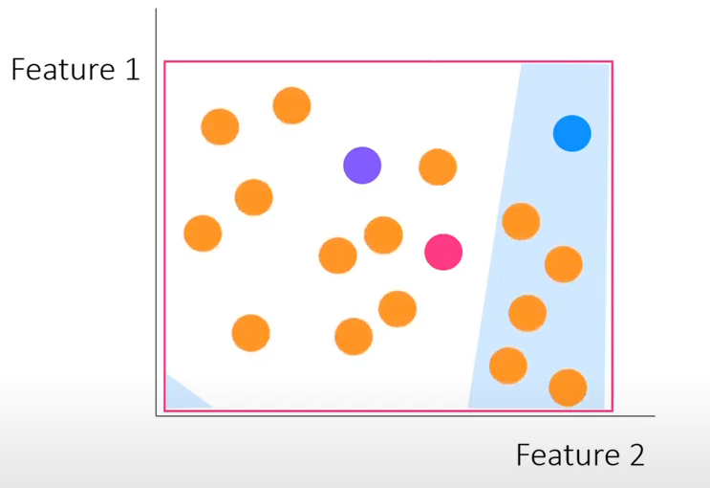
Explainable Artificial Intelligence for Diabetes Prediction
Perturb your dataset and get the black box predictions for these new points

Slide 20
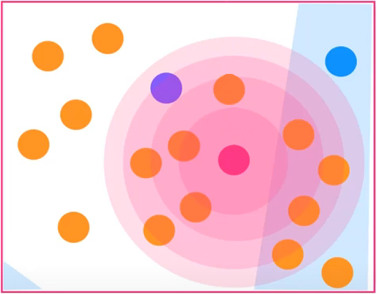
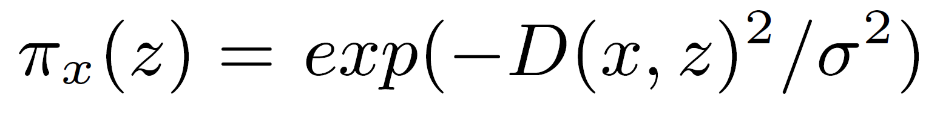

Explainable Artificial Intelligence for Diabetes Prediction
Weight the new samples according to their proximity to the instance of interest
Some distance function D
Kernel width

Slide 21
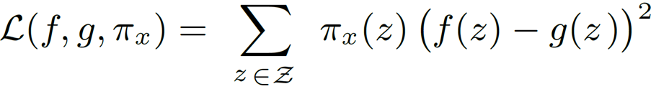
Explainable Artificial Intelligence for Diabetes Prediction
Train a weighted, interpretable model on the dataset with the perturbed instances
Complex model
prediction
Simple model
prediction
?
LIME uses sparse linear models (LASSO)

Slide 22
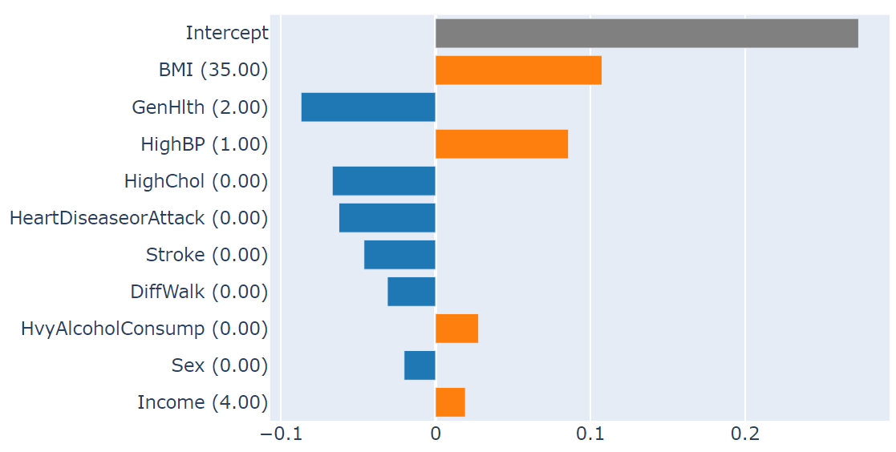
Explainable Artificial Intelligence for Diabetes Prediction
Explain the prediction by interpreting the local model

Slide 23
Explainable Artificial Intelligence for Diabetes Prediction
LIME DISADVANTAGES
Neighborhood
Sampling data
Instability

